Slide 1

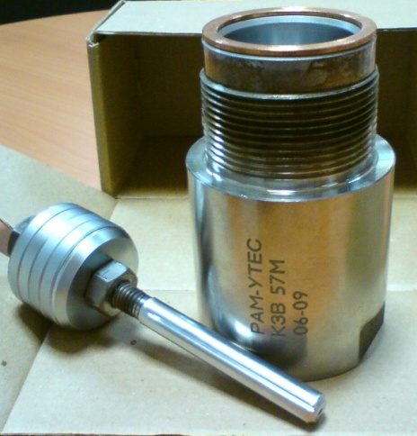
“RAM” LLC and its
Nano-Diamond Chrome (NDC) cover technology

Slide 2
Facts about “RAM” LLC
RAM LLC company was incorporated in 2004 as a design and experimental enterprise. Our objective is development, production and distribution of high-quality innovative equipment and solutions in the field of engineering, dealt with oil production as well as other sectors of industry.
By 2006
Nano-diamond chroming (NDC) technique has been developed in cooperation with the specialists
of EKA OJSC. The technique allows covering units and details with chrome coat which
improves their durability as compared to the existing analogues.
By 2008
RAM has developed and mastered manufacturing of slide valves for domestic and imported
oil extracting pumps. These slide valves reduce cost of oil production, equipment repair
and energy expenditures.
2011
RAM starts development of BeeOilPump – a new rod pumping unit
which is being produced until today
2012
RAM has developed equipment for accelerated life test of slide valves and
deep-well pumping equipment.
2015
RAM is moving to USA and other international market places to launch
new products based on NDC technology

Slide 3
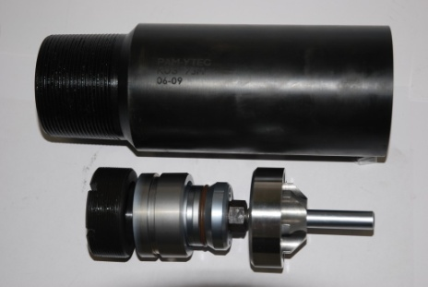
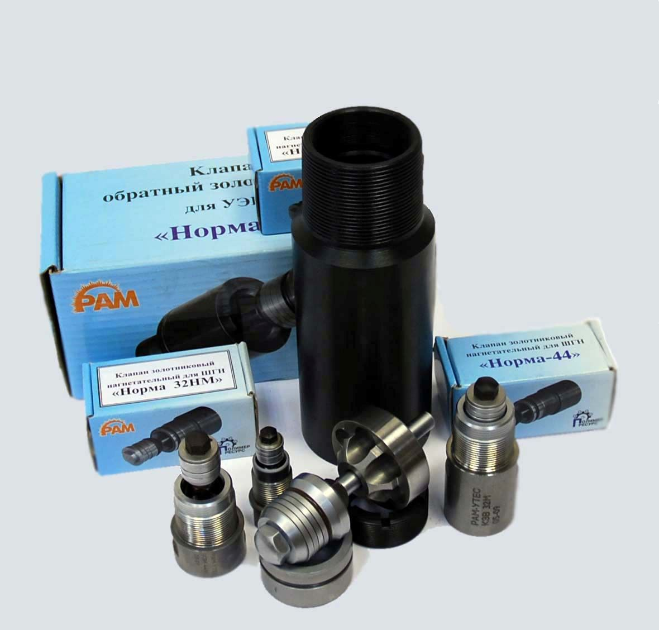
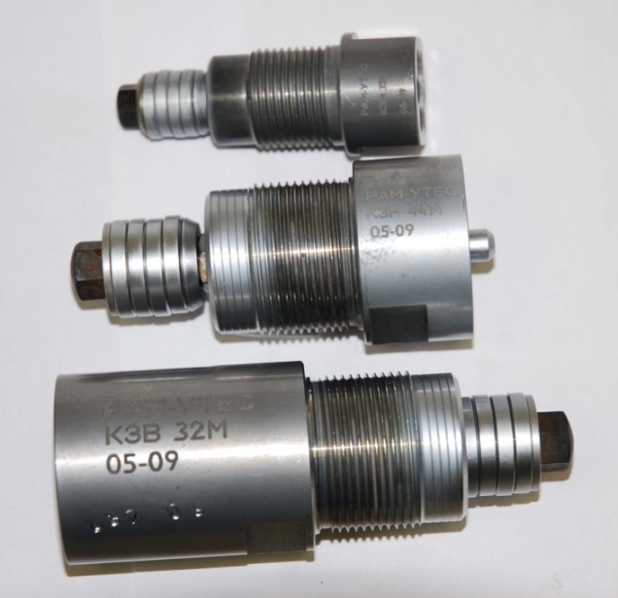
NDC Valve Units, produced by “RAM” LLC

Slide 4
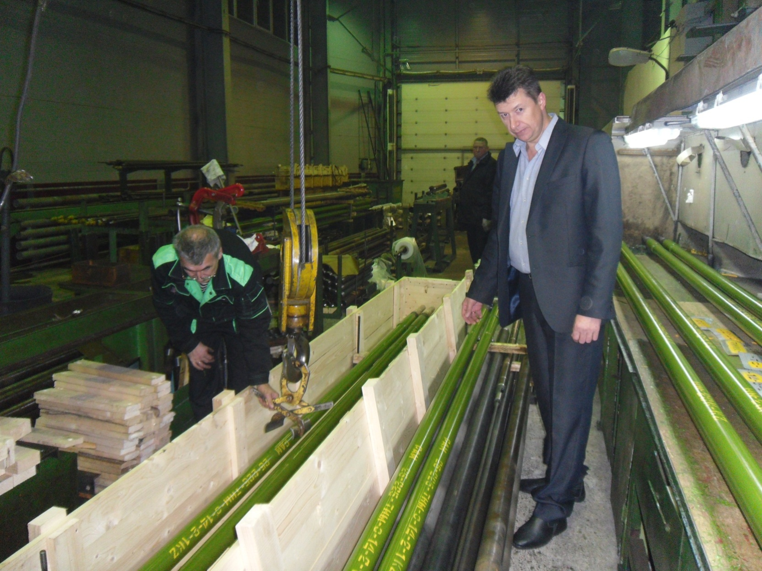
Photo SRP of «BeeOilPump», produced by LLC “RAM”

Slide 5







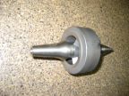




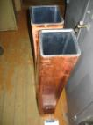

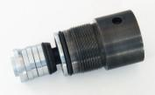


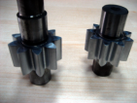

The industrial purpose of NDC
Nano-Diamond Chroming (NDC) technology is used instead of normal chrome coating to increase the durability of parts working in heavy duty conditions
Where the NDC is used
Light Industry
Aerospace
Medical Devices
NDC
Machine building
Oil Industry
Nuclear Industry
Aircraft Industry

Slide 6
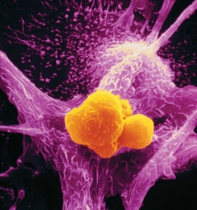

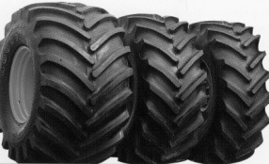
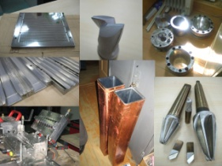
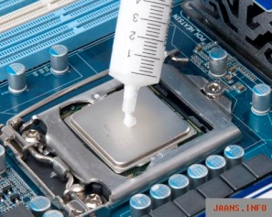

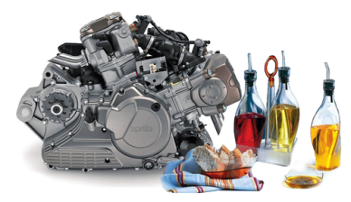
Nanodiamond alternative usage
Polymer / Rubber
filling compound
Bio Application
Different Surfaces
NanoDiamond
Heat removal
in electronics
Machine oil additives
Combustion
and detonation
catalyst

Slide 7
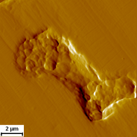
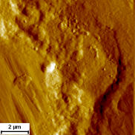
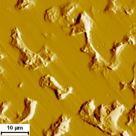
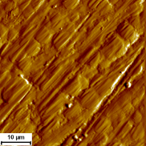
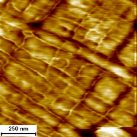
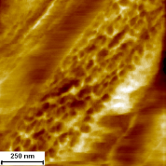
How it works
Normal Chrome Coat structure
NDC structure (LLC RAM technology)
Thanks to adding the detonation synthesized nanodiamonds
the surface structure becomes fine-grained and dense.

Slide 8
NDC key characteristics
Key Characteristics | NDC cover (LLC RAM) and normal chrome cover properties comparison
Microhardness | NDC microhardness is more than 1,5 - 2 times higher
Wear-resistance | NDC wear-resistance more than 2 – 5 times higher
Friction coefficient | NDC friction coefficient is 6 - 15% lower
Cohesion strength | NDC cohesion strength is more than 1,1 - 1,9 times higher
Ductility | NDC ductility is more than 2-6 time higher

Slide 9
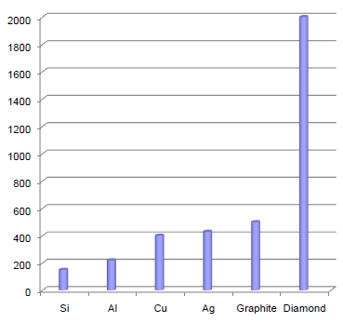
Nanodiamonds key properties
Heat conduction comparison of diamond, silicon,
aluminum, copper, silver and graphite. (Wt./m*K)
NDC properties:
Extremely high heat conduction (2000 Wt./m•K);
Fully dielectric material;
Small size (4-5 nm in average);
Large specific surface (220-450 m²/g)
The NDC cover consists of different functional elements allowing to obtain stable chemical bond of unique nano-chrystal and the molecules from the required cavity block

Slide 10
6 key benefits for the customers who use NDC
1) Warranty cost reduction due to longer life of such elements as valves, valve cams, engine pistons and rings, bearings, transmission elements, gears, pinions and etc (for automotive industry)
2) Longer life of elements which work in heavy duty conditions (e.g industrial pumps, forging)
3) Ability to repair machine parts worn surfaces instead of replacing the whole assembly
4) Decreased service interval
5) Possibility to design new type of machines and production equipment with increased productivity and durability
6) Easy implementation of NDC technology at the already existing galvanizing line (minimum investment-maximum output)

Slide 11
What “RAM” LLC offers today:
  Application of high-wear-resistant coating «Diamond-cluster coating» (NDC) according to the customer’s requirements
  Development and implementation of prospective technologies, materials and tools in mechanical engineering, oil production, oil transportation and storage, ecology and environmental protection;
  Conduction of scientific researches, design, pilot-plan, calculation and experimental works in development of new equipment and advanced technology;
  Establishment of engineering, technical and production base to ensure implementation of obtained scientific results;
  Implementation of design solutions and prototype models of our developments based on licensed rights.
  Polymeric composite materials with ultra-high heat conductivity
  Full and standard warranty for all the products
  Technical Support and Customer Care

Slide 12

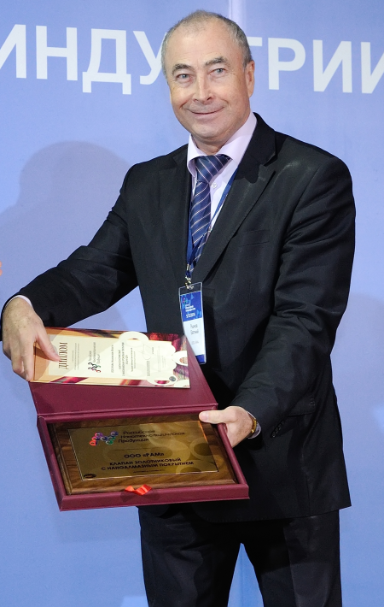
Contact Information
“RAM” LLC
141090 Russia, Moscow region, Korolev, Yubileyniy, Pionerskaya, 1/4
tel.+7 (495) 544 27 27.
Web: http://www.ramoiltech.com/
E-mail: mail@ramtech.su
Chairman of board
Eugene V. Ryzhov

